Slide 1
MongoDB operations
Deepak Srinivasan

Slide 2
Index
1. Data Base
1.1. Databases view 1.2. Database Use
2. Collection
2.1. Create Collection 2.2. Drop Collection
3. Insert
3.1. Insert One 3.2. Insert Many
4. Update
4.1. Update One
4.2. Update using $inc
4.3. Update using $mul

Slide 3
Index
5. Delete
5.1. Delete One 5.2. Delete Many
6. Find
6.1. Find One 6.2. Find all name & age 6.3. Find using $and, $gt
7. Stats
7.1 Stats() before inserting Document. 7.2. Stats() after inserting Document
8. One to One Relationship (Patient & Disease)

Slide 4
Index
9. One to Many Relationship (Patient & Disease)
10. One to Many Relationship (Paper & Answer)
11. Many to Many Relationship (Authors & Books)
12. Many to One Relationship (Authors & Books)
13. Aggregate
14. Validation
15. Write Concern
16. Next() → shows first 20 documents
17. ForEach → shows all documents

Slide 5
1.1. Databases view 1.2. Database Use
To view all the database
Eg: > show databases
To use particular database or to create new database
Eg: > use “database name”
To drop database
Eg: > db.dropDatabase();

Slide 6
2.1. Create Collection 2.2. Drop Collection
To create collection in database
db.createCollection(‘”Collection name”’);
To delete collection in database
db. ”Collection name”.drop();
To display collection
show collections

Slide 7

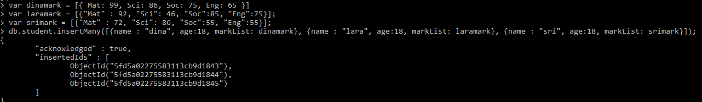
3.1. Insert One 3.2. Insert Many

Slide 8
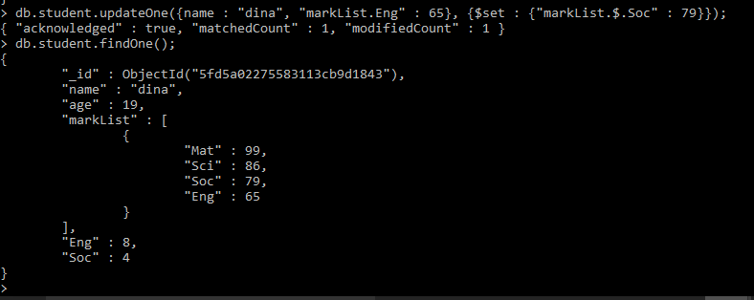
4.1. Update One

Slide 9
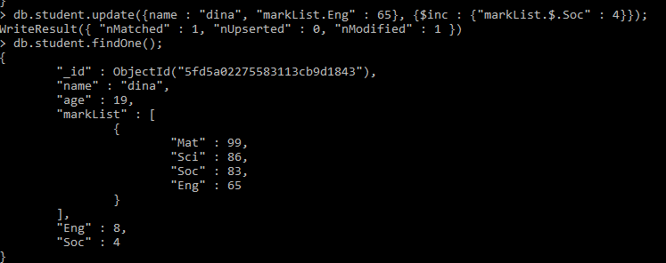
4.2. Update using $inc

Slide 10
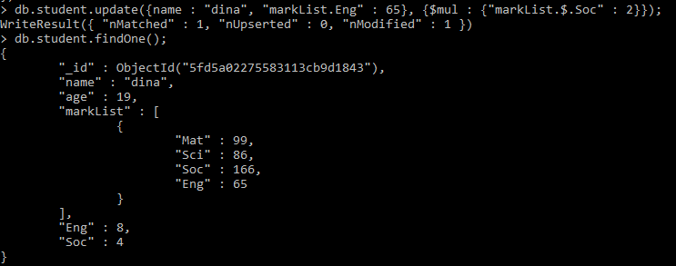
4.3. Update using $mul

Slide 11
5.1. Delete One 5.2. Delete Many
To delete one document
db.”collection name”.remove({“name": “dina"});
WriteResult({ "nRemoved" : 1 })
To delete All document
db.”collection name”.remove({});

Slide 12
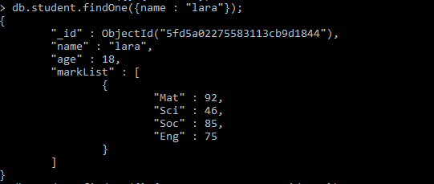
6.1. Find One

Slide 13

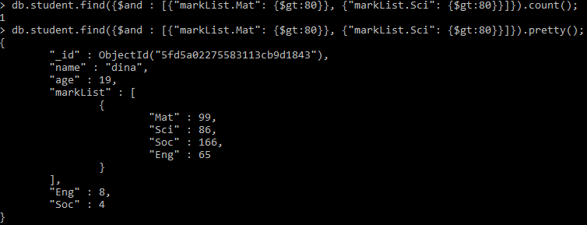
6.2. Find all name & age 6.3. Find using $and, $gt

Slide 14
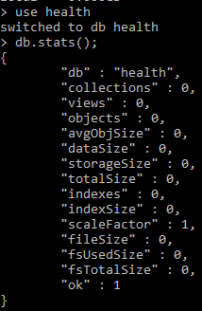
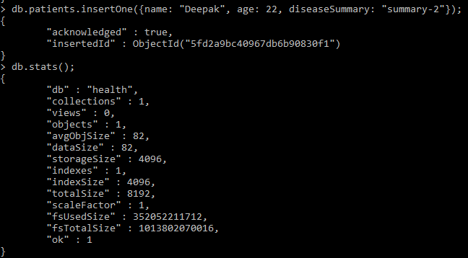
7.1. Stats() before inserting Document. 7.2. Stats() after inserting Document

Slide 15
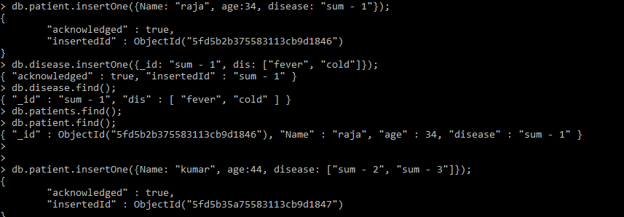
8. One to One Relationship (Patient & Disease)

Slide 16
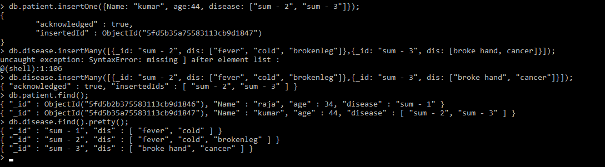
9. One to Many Relationship (Patient & Disease)

Slide 17
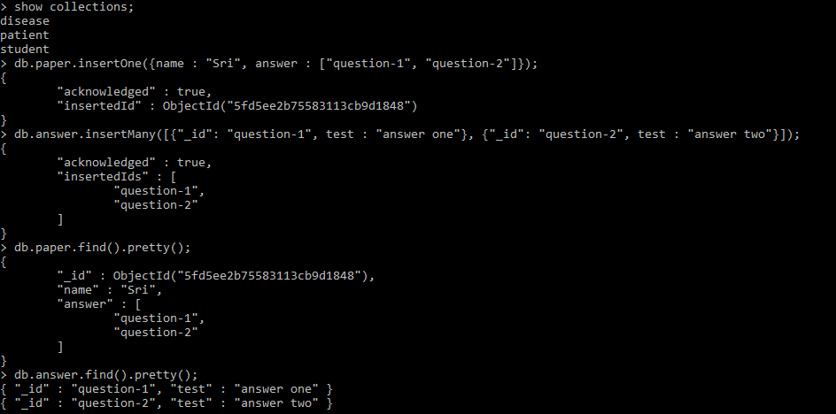
10. One to Many Relationship (Paper & Answer)

Slide 18
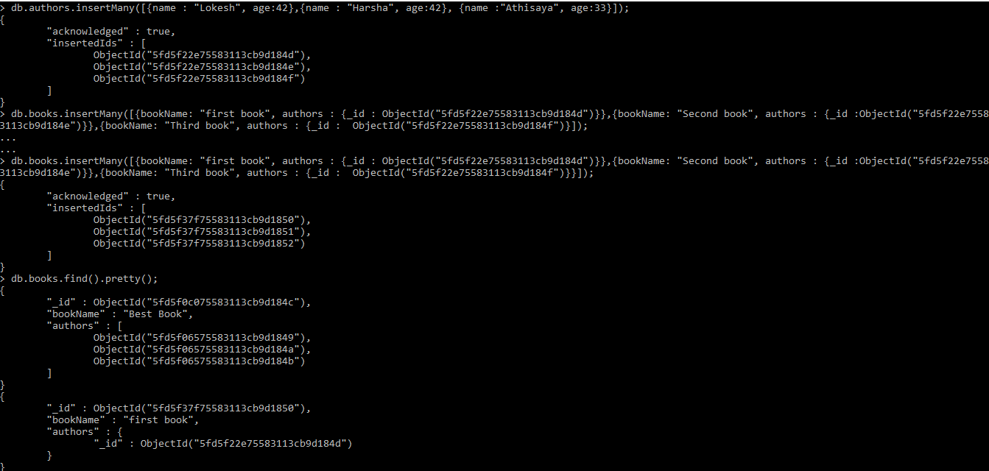
11. Many to Many Relationship (Authors & Books)

Slide 19
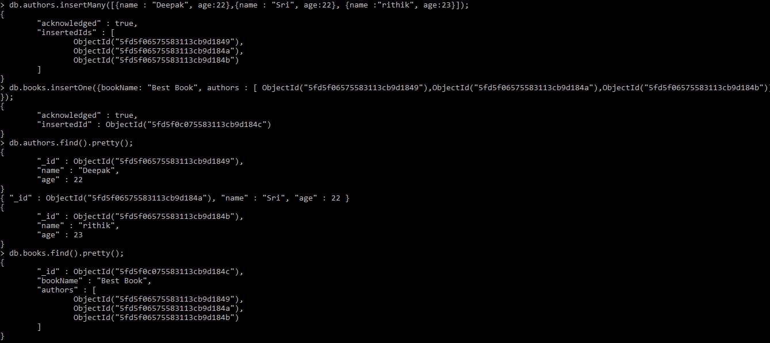
12. Many to One Relationship (Authors & Books)

Slide 20
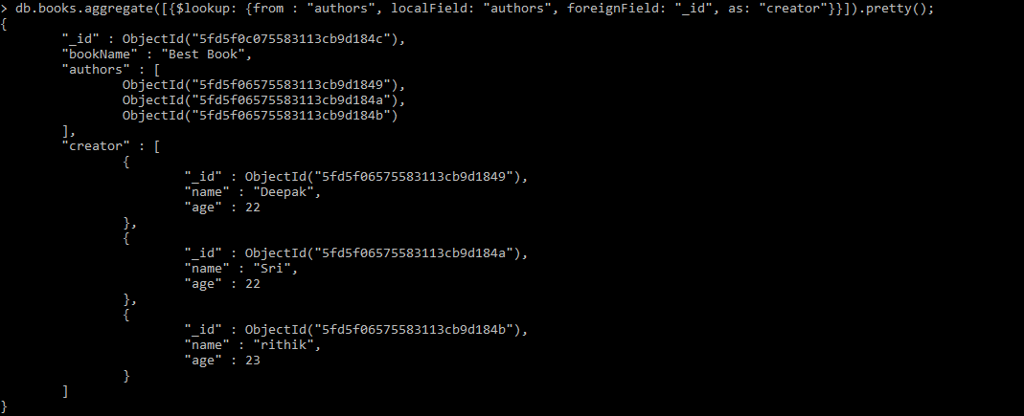
13. Aggregate

Slide 21
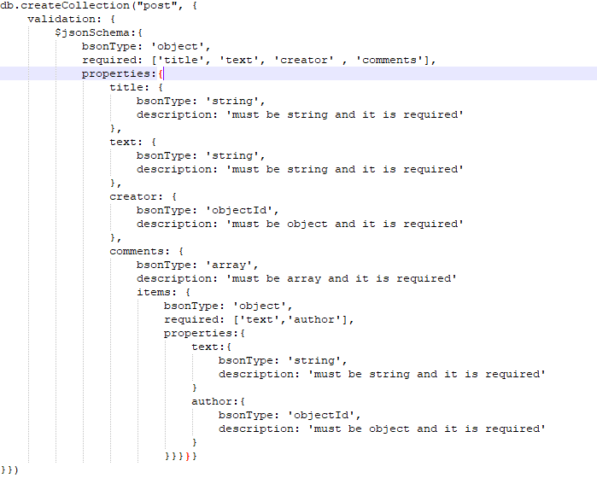
14. Validation

Slide 22
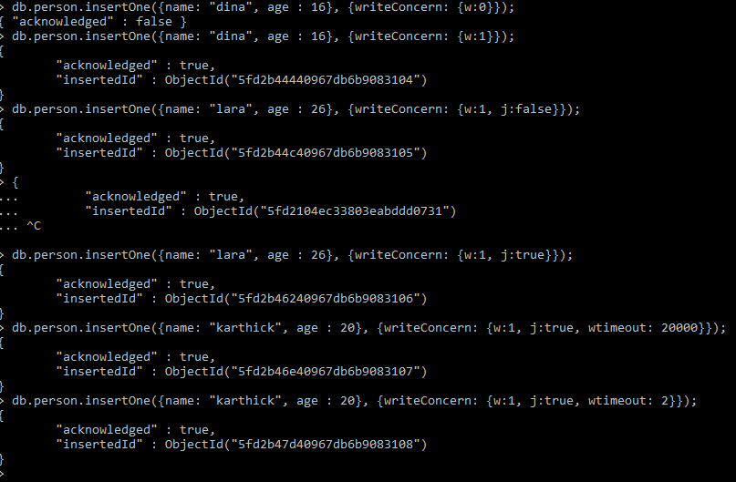
15. Write Concern

Slide 23

16. Next() → shows first 20 documents 17. ForEach → shows all documents

